Slide 1



Crane GatePass & SafetyCheck
Alert Notification System
alqama.hasnain@tatasteel.com
FMM-Infrastructure

Slide 2


PROBLEM STATEMENT
High Error Susceptibility
Reactive Response
Manual checking of dates daily is prone to oversight. Busy schedules and cognitive load may lead to missed validity milestones.
If the expiration is identified after the deadline has passed, there would operational delays and grounding of equipment.

Slide 3
PROBLEM STATEMENT
The Compliance Gap
100%
Without automated intervention, the integrity of Crane Gatepass and Safety Checks rests solely on administrative bandwidth. This introduces a single point of failure in site safety protocols.
HUMAN RELIANCE

Slide 4



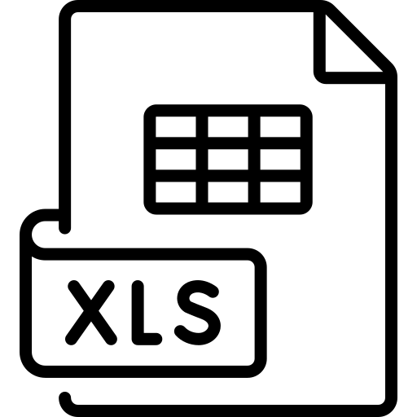
THE SOLUTION
Automated Notification System for Crane Gatepass & Safetycheck Expiration Alerts
Cloud Logic
Proactive Monitoring
Centralized Data
Program runs daily on cloud triggers, removing local dependence.
Advance warnings enable proactive renewal of Safety Checks and Gatepass.
Dynamic link between spreadsheets and notification payloads.

Slide 5


INTEGRATION ARCHITECTURE
System Workflow
By linking Microsoft Excel with Power Automate (or Google Sheets with AppScript), we created a self-sustaining loop.
The system evaluates dates daily and triggers personalized emails based on a defined recipient list within the same excel sheet.

Slide 6
DATA FRAMEWORK
VEHICLE NAME | REGISTRATION NUMBER | GATE PASS VALIDITY | SAFETY CHECK VALIDITY | NOTIFICATION STATUS
450T Crane | MH46CR-1192 | 04/28/2026 | 03/13/2027 | Monitoring
350T-1 | OD34Y-9927 | 04/21/2026 | 03/10/2027 | Alert Triggered
Trailer Unit | JH05EH-4547 | 06/20/2026 | NA | Monitoring
80T-1 | GJ15SV-2323 | 04/29/2026 | 09/19/2027 | Pending Warning

Slide 7


NOTIFICATION LOGIC
Stage 1: Warning
Stage 2: Critical
Notifications are triggered 7 days prior to expiration. This provides a lead-time buffer for physical inspections and documentation prep.
Immediate escalations are sent if dates have already expired, ensuring assets are not utilized in a non-compliant state.

Slide 8
IMPACT
Zero Human Error
Cloud triggers ensure no expiration date is ever overlooked.
Proactive Maintenance
7-day windows enable teams to schedule safety checks without disrupting operations.
Resource Optimization
Administrative staff are freed from manual auditing, reallocating hours to high-value tasks.
Audit Readiness
Centralized, updated logs provide instant verification for site safety audits.

Slide 9
THANKYOU

